Slide 1

Electronic Health Record (EHR): Who uses it?
Notes:
Electronic Health Record, simply put, is a digital version of patient’s paper chart. EHRs are real-time records that make information, such as patient’s medical history, diagnoses, medications, etc, available instantly to authorized medical providers.

Slide 2
Notes:
It helps with more efficient workflow and communication among medical care providers and thus, helps to make well-informed decisions about a patient’s care in timely manner.

Slide 3
(SKIP)EHR use in the U.S.
State-level EHR use graph

Slide 4

3,334 Hospitals
[] Individual Practitioners
Notes:
We investigated characteristics of hospitals that is associated with higher use of EHR.
Furthermore, we investigated individual medical practitioners who are not affiliated with hospitals, to see which individual-level demographics are associated with higher use of HER.

Slide 5
Notes:
As of 2017, []% of U.S. Hospitals have adopted Electronic health Records.

Slide 6
(SKIP)EHR use in US Hospitals
As of 2017, []% of U.S. Hospitals have adopted Electronic health Records.

Slide 7
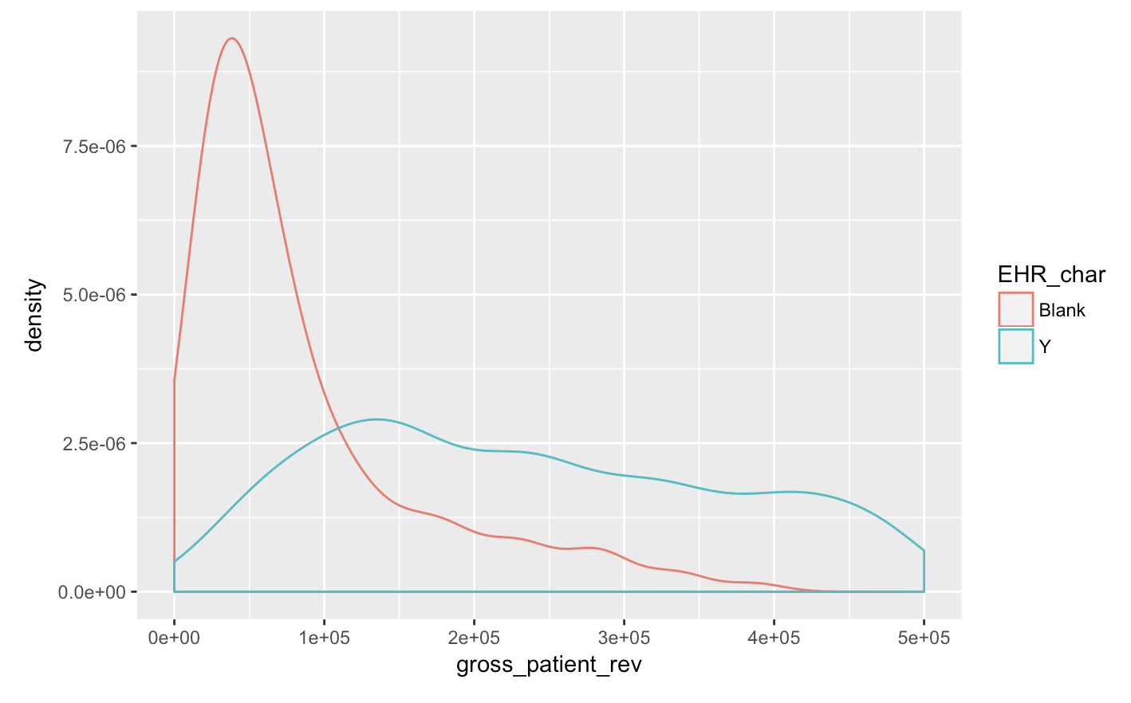
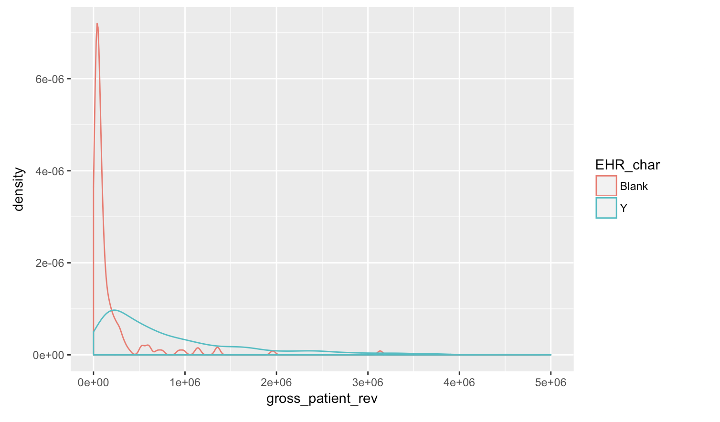
Explore Correlations
Notes:
Among 3,334 hospitals scraped from American Hospital Directory, we found out that the gross patient revenue and total discharges are the most significant predictors of whether a hospital uses EHR or not. As we can see from the density plots, which uses distribution of gross revenue for EHR-adopted hospitals in green and non-EHR adopted hospitals in green, we can see that the hospitals that do not use EHR have lower gross patient revenue. Let’s look closely into hospitals that do not use EHR, and we can see that most of these hospitals have gross patient revenue below 40,000.

Slide 8
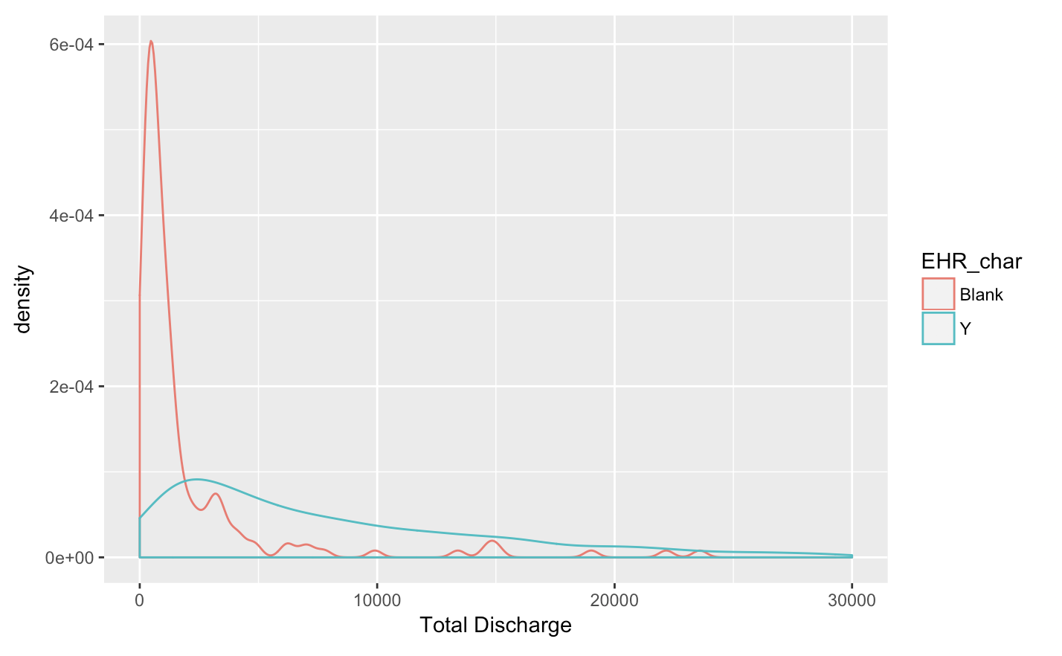
Notes:
Similarly for total discharge, hospitals that do not use EHR have lower total discharge in general.

Slide 9

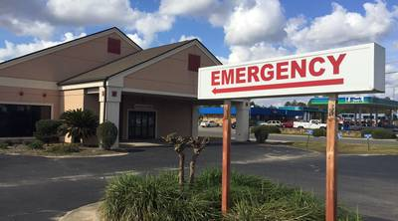
Greater amount of revenue
Greater discharge
EHR Use
Notes:
We believe the both variables are related to hospital size. In essence, hospital size is the biggest predictor of the EHR use. In order to increase EHR use, we should target small hospitals.

Slide 10
Individual Practitioners
Notes:
Furthermore, we were curious to find out what are personal characteristics of individual practitioners associated with EHR use?

Slide 11
(SKIP) Practitioner demo – EHR use
Among [number] practitioners in our dataset, [%] uses EHR.
In particular, we were curious to find out if younger practitioners would be more likely to use EHR, since they were more familiar with digital techniques.

Slide 12
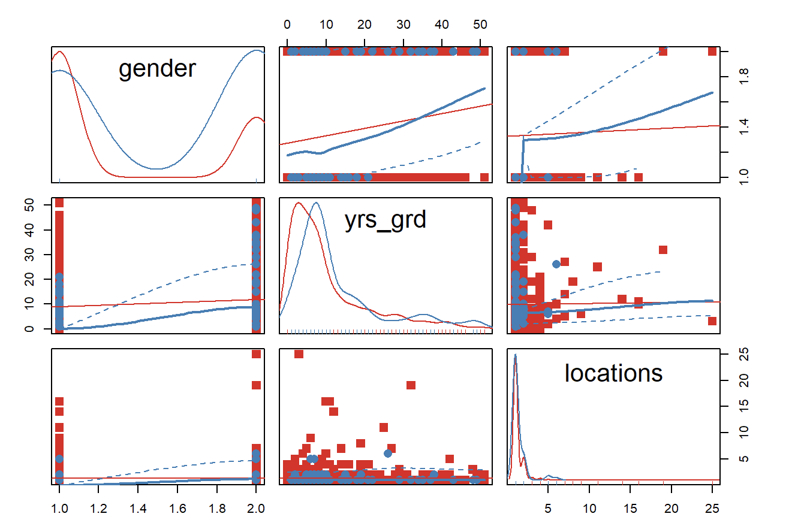
Physician.- exploratory plots
Notes:
Among [number] practitioners in our dataset, we looked into characteristics such as years since earning the clinical certificate, primary specialty, gender. Among these characteristics,
we found out that gender and years since graduation have significant predictors of whether a practitioner uses EHR or not.

Slide 13
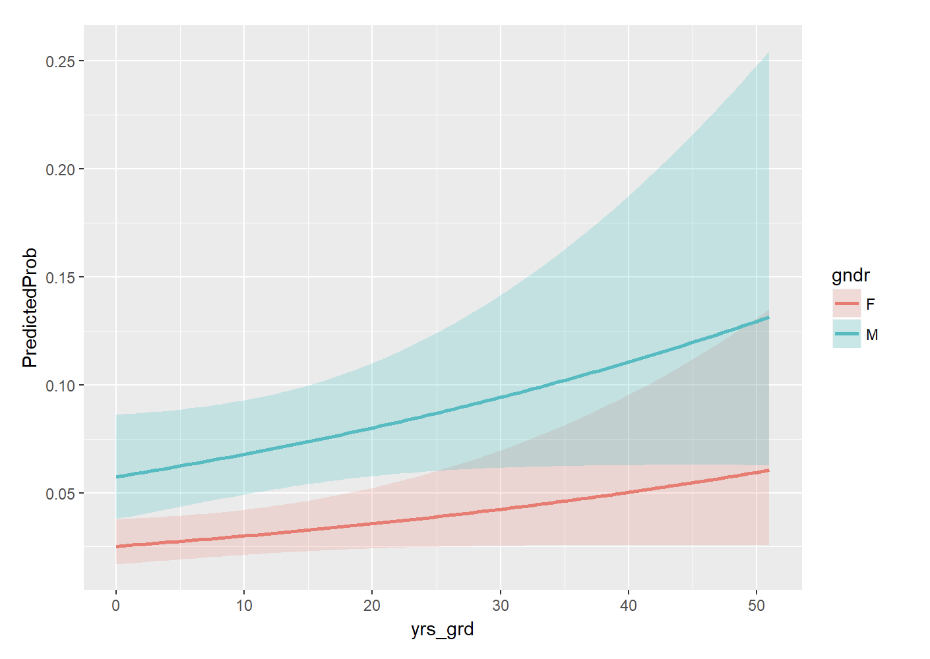
Summary: what type of physicians are more likely to use EHR?
MALE
OLDER
EHR Use
Notes:
YOU CAN SEE FROM our models that []
The odds of using HER is 2.35 times higher for male practitioners than female practitioners, and it is 1.02 times higher per a year increase in the year since graduation. In essence, the longer since medical-school graduation, the more likely you are to use EHR! If we assume that people graduate from medical schools around same age, this is indicating older physicians are more likely to use EHR, breaking our stereotype that younger physicians are more likely to adopt HER!

Slide 14
Conclusion
Small hospitals of yearly gross revenue under $400,000.
Among individual practitioners target younger, female practitioners
Notes:
In order to increase EHR use, we should target small hospitals. Among individual practitioners, we should try to increase HER use among younger, female practitioners.

